Slide 1

Home
Page 01
Manufacturing analytics

Slide 2



Home
Page 02
Table of Contents
Our Team
Project Summary
KPIs List
KPIs Explaination
Excel Dashboard
Power BI Dashboard
Tableau Dashboard
SQL Screenshot
Key Takeaways

Slide 3

Home
Our Team
Page 08
Praful Prakash Dudhewar
Golla Niharika
Samiksha Madhusudan Dhore
Yash Jagtap
Geethapriya Kalaiselvan
Prachi Saxena

Slide 4
Project summary
Home
Page 01
Scope of Analysis
The analysis focuses on production trends over time, department-wise performance, machine and employee efficiency. It also examines rejection and wastage patterns to identify inefficiencies and operational gaps.
Business Objective
The objective is to analyze manufacturing data to enhance production efficiency, minimize rejection rates and optimize overall operational performance through informed ,data-driven decisions.
Tools and Analysis Approach
This project uses Excel for data cleaning and KPI development,along with SQL for efficient data extraction and querying. Interactive dashboards were created using Excel, PowerBI and Tableau to present insights clearly and support effective decision-making.

Slide 5
Home
Page 01
Key performance indicators(KPIs)
Manufacture Qty: Total quantity of items produced within a given timeframe.
Rejected Qty: Number of units that failed quality checks and were rejected.
Processed Qty: Quantity of items that completed specific manufacturing stages.
Wastage Qty: Materials or items lost during the production process.
Employee Wise Rejected Qty: Rejection count attributed to individual employees for accountability and training.
Machine Wise Rejected Qty: Tracks machine-specific rejections to identify underperforming equipment.
Production Comparison Trend: Visual trends of production over time to analyze performance patterns.
Manufacture Vs Rejected: Direct comparison of produced and rejected quantities to assess quality ratios.
Department Wise Manufacture Vs Rejected: Department-level breakdown of production versus rejection to identify area-specific issues.

Slide 6
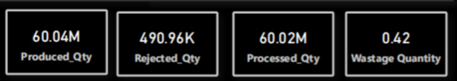
KPIs Explaination
Home
Page 01
Manufacture QuantitySUM(M_Qty)
Total units produced within a given timeframe. It measures the gross capacity utilization and operational scale of the facility.
Helps in capacity planning and machine utilization
Supports demand vs production decisions
Helps reduce under/over production costs
Rejected QuantitySUM(R_Qty)
Total items failing quality checks. Essential for identifying machine malfunctions or batch errors before delivery.
Identifies quality issues & machine failures
Helps in supplier/vendor decisions
Supports process improvement & maintenance planning
SUM(Manufactured Qty)
Rejected Quantity
SUM(Rejected Qty)
Wastage Quantity
SUM(R Qty/Sum(P Qty)
Wastage QuantitySUM(R_Qty) / SUM(P_Qty)
Ratio of lost material to net output. Monitors material efficiency and helps in reducing operational scrap overhead.
Helps improve profitability & cost control
Measures production efficiency
Supports waste reduction & sustainability goals
Processed QuantitySUM(M_Qty) - SUM(R_Qty)
Net items successfully completing all manufacturing stages. Represents total saleable output ready for inventory.
Used for revenue forecasting & sales planning
Shows actual sellable inventory
Helps in delivery & stock management

Slide 7
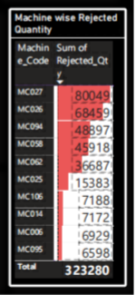
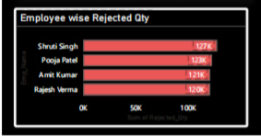
KPIs Explaination
Home
Page 01
Machine wise Rejected Quantity
SUM(Manufactured Qty)
This visual highlights the technically unreliable machines, which needs the maintenances and the most experienced technicians to troubleshoot the high-rejection machines.
Decision :
1)If a machine like MC027 consistently appears at the top despite repairs, the data provides a financial justification to replace the equipment rather than continue costly, ineffective maintenance.
2) Audit the operators assigned to the top five machines. If the high rejection rate follows a specific shift or person, the decision should be to provide targeted retraining rather than mechanical repair.
Rejected Quantity
SUM(Rejected Qty)
Wastage Quantity
SUM(R Qty/Sum(P Qty)
Employee wise Rejected Quantity
Since all four employees have almost identical rejection percentages (0.81% to 0.82%), the problem likely isn't "bad employees." It suggests a systemic issue—such as a flaw in the standard operating procedure (SOP), raw material quality, or the machines themselves.
By showing "Produced Qty" alongside "Rejected Qty," it prevents unfair blaming. Shruti Singh has the highest total rejections, but because her production volume is also the highest, her actual error rate (0.82%) is nearly the same as the others.

Slide 8
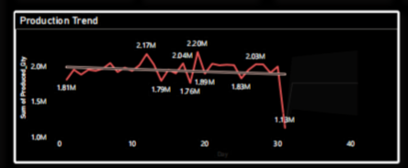
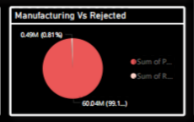
KPIs Explaination
Home
Page 01
Production Comparison Trend
SUM(Manufactured Qty)
This visual shows the daily fluctuations of production quantity, which is between 100,000 and 250,000 units.
The black linear trend line is almost perfectly horizontal. This tells the overall production capacity is stagnant—and the production is not growing or declining over the long term.
Decision : Since the linear trend is flat, we cannot expect that this setup will fullfill the high demand sales. For getting the upward linear trend, we have to invest in new machinery or optimize existing workflows.
Rejected Quantity
SUM(Rejected Qty)
Wastage Quantity
SUM(R Qty/Sum(P Qty)
With this visual we know that there is 99% Success Rate, i.e. Out of every 100 units produced, 99 are good.
Decision : While the 490,964 rejected unit looks very less, but this represents a massive amount of lost material, labor, and potential revenue. To reduce the rejected units "Six Sigma" projects or new quality control technology can be introduced.
Manufacture Vs Rejected

Slide 9
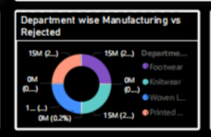

KPIs Explaination
Home
Page 01
Department Wise Manufacture Vs Rejected:
This visual shows that the Printed Fabric has the lowest total production but a visibly higher proportion of rejections compared to its output, also, Woven Labels also shows a significantly larger rejection block relative to Footwear or Knitwear.
Decision : Since the Printed Fabric have the highest visible scrap ratio, fixing a single issue there will yield the highest return on investment.
Investigate vendor quality for the "Printed Fabric" and "Woven Labels" departments. You may decide to switch to a higher-grade supplier for those specific materials to reduce the scrap rate.
SUM(Manufactured Qty)
Rejected Quantity
SUM(Rejected Qty)
Wastage Quantity
SUM(R Qty/Sum(P Qty)

Slide 10
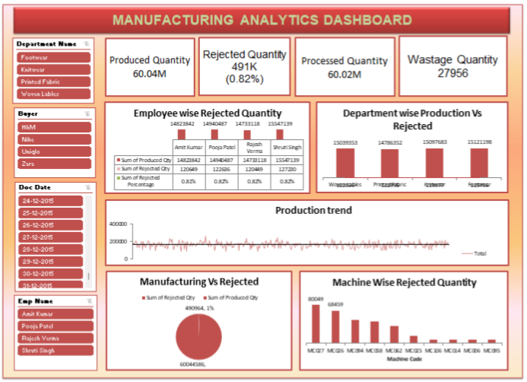
Excel dashboard
Home
Page 01

Slide 11
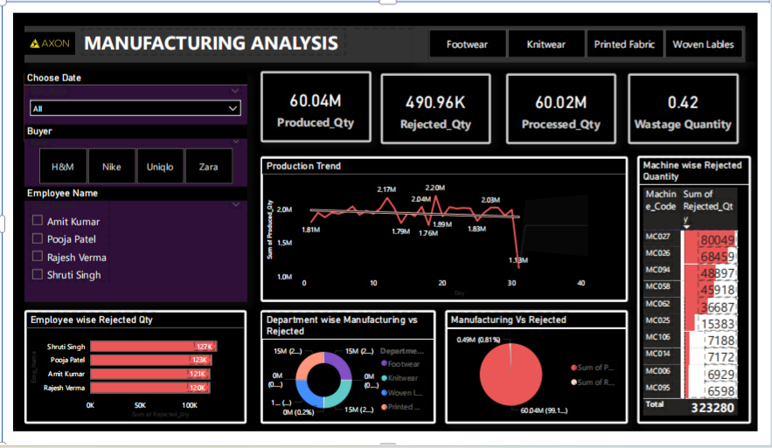
Power BI dashboard
Home
Page 01

Slide 12
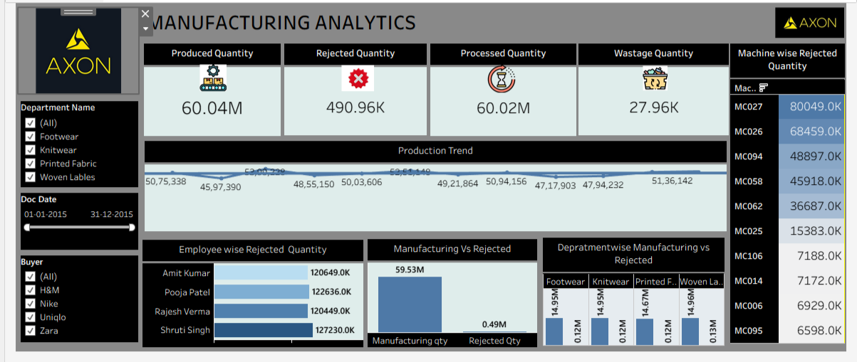
tableau dashboard
Home
Page 01

Slide 13
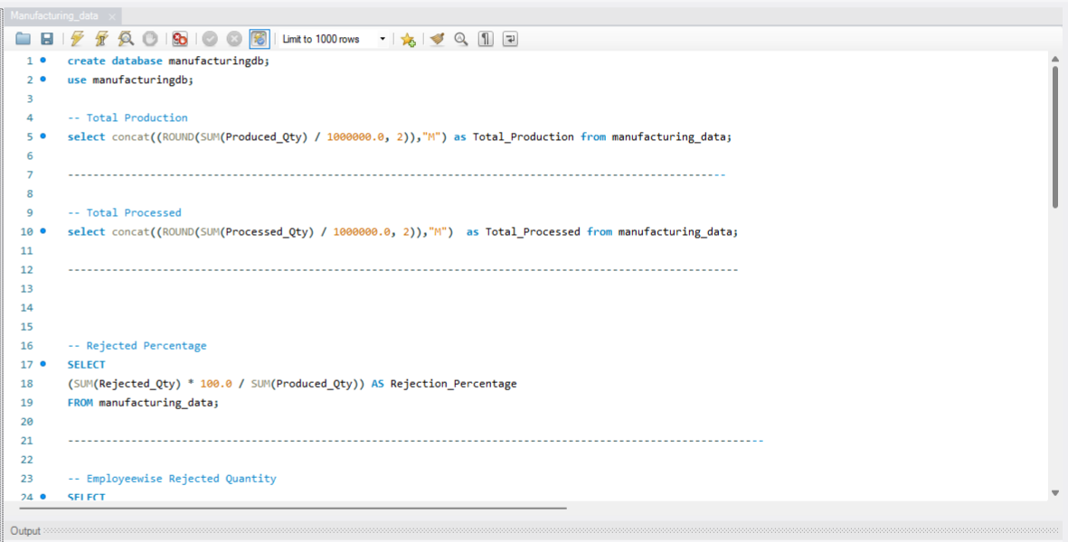
sql Screenshot
Home
Page 01

Slide 14
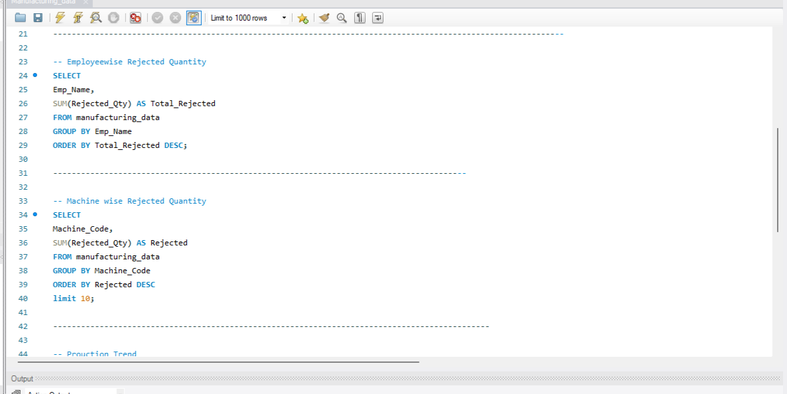
sql Screenshot
Home
Page 01

Slide 15
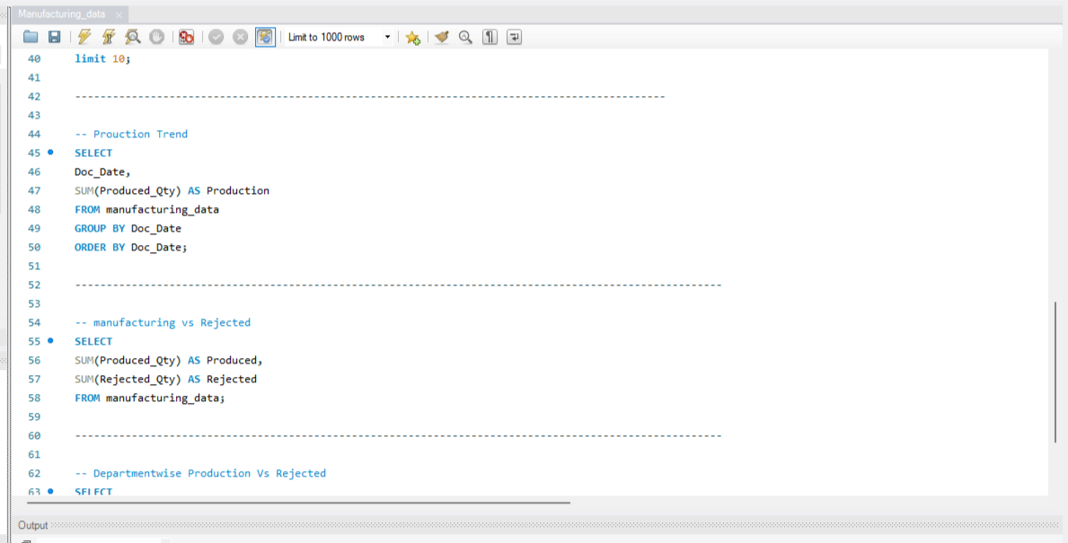
sql Screenshot
Home
Page 01

Slide 16
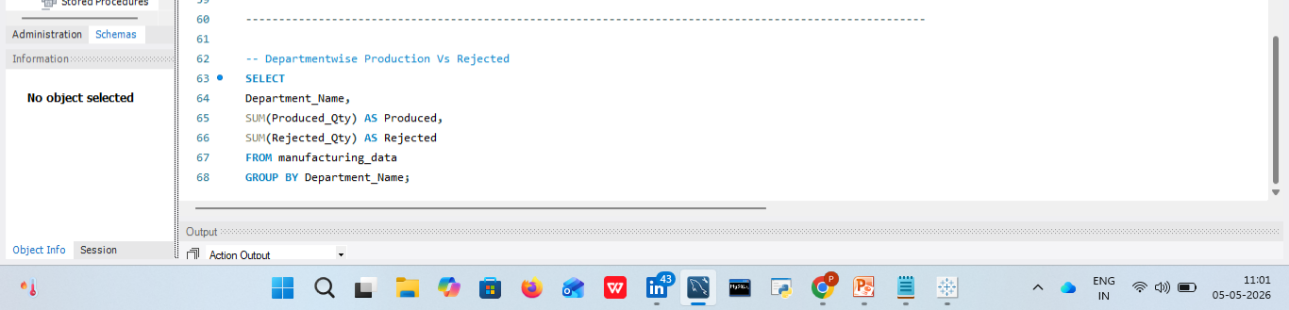
sql Screenshot
Home
Page 01

Slide 17
Key takeaways
Home
Page 01
5. Employee-Level Rejections Show Performance Gap
Top reject contributors:
Shruti Singh (~127K)
Pooja Patel (~123K)
Indicates skill gap / training opportunity / process adherence issues
6. Machine-Specific Quality Issues
Machines like MC027 & MC026 contribute highest rejections
Suggests:
Maintenance issues
Calibration problems
Opportunity for predictive maintenance
7. Department Performance is Consistent but Not Optimized
All departments operating at ~99% efficiency
However, near-identical performance suggests:
Lack of differentiation in process optimization
Scope for benchmarking best-performing units
8. Rejection vs Production Gap Still Scalable
Even at <1% rejection:
Absolute rejected volume = ~491K units
Small improvements → large financial gains
1. Strong Production Efficiency
Total Production (60.04M) is closely aligned with Total Processed (60.01M)
Indicates minimal process bottlenecks and high throughput efficiency
2. Low Overall Rejection Rate
Rejection % at ~0.82% reflects strong quality control systems
Majority (~99.2%) of production meets quality standards
3. Wastage Under Control but Not Negligible
Wastage at 28.83K units is relatively low vs total volume
However, even small % losses at scale = significant cost impact
4. Stable Production Trend with Minor Fluctuations
Production trend shows consistent output (~5M/month range)
Slight dips indicate possible seasonal or operational inefficiencies
SUM(Manufactured Qty)
Rejected Quantity
SUM(Rejected Qty)
Wastage Quantity
SUM(R Qty/Sum(P Qty)

Slide 18
THANK YOU!

